Slide 1
Detection and Classification of Vegetation and Other Low-Contrast Targets
Final Project
Machine Learning for Remote Sensing
{name, date, email}

Slide 2
Requirements:
Complete slides (introduction, etc.)
Run: ACE and MF, plot histograms of scores on and off ROIs, and compute ROC curves. (This requires resampling spectra, etc.)
Add at least one more processing method (using unmixing, neural networks, LDA, etc. – training on image pixels and / or library spectra)

Slide 3
abstract
Target detection in hyperspectral imagery generally involves targets that occupy only a few pixels and have a high contrast to the background. For example, likelihood-ratio-based methods such as ACE and MF assume target spectra with a low likelihood of being in a background class measured from the image. However, situations such as detecting specific vegetation species within a vegetation background do not follow the few-pixel or high-contrast assumptions. In this paper we present new data and results on the low-contrast target problem, focusing on carefully ground-truthed vegetation imagery.

Slide 4
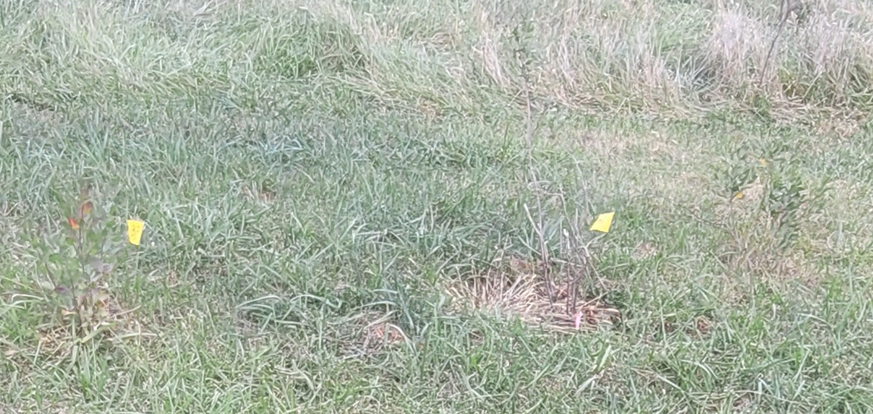
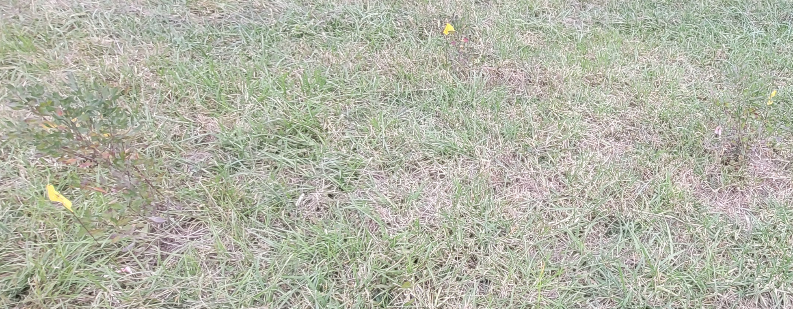
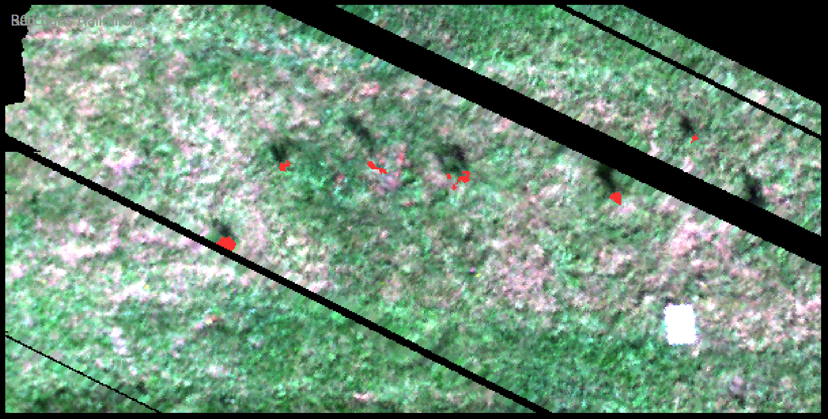
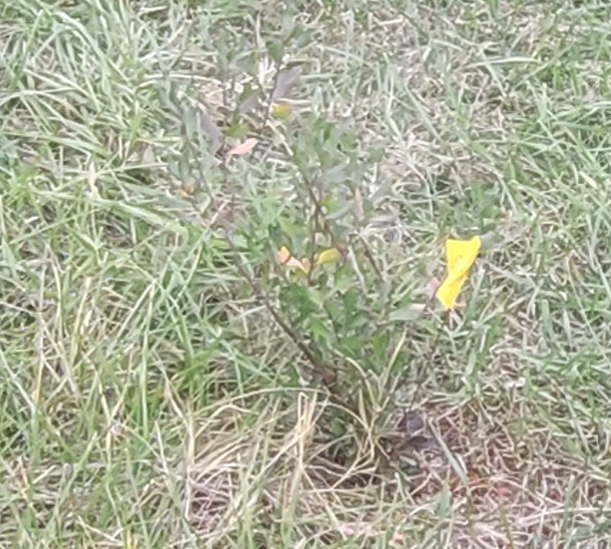
RGB Image with ROIS
(shadow is visible,
plant is in non-data area)

Slide 5
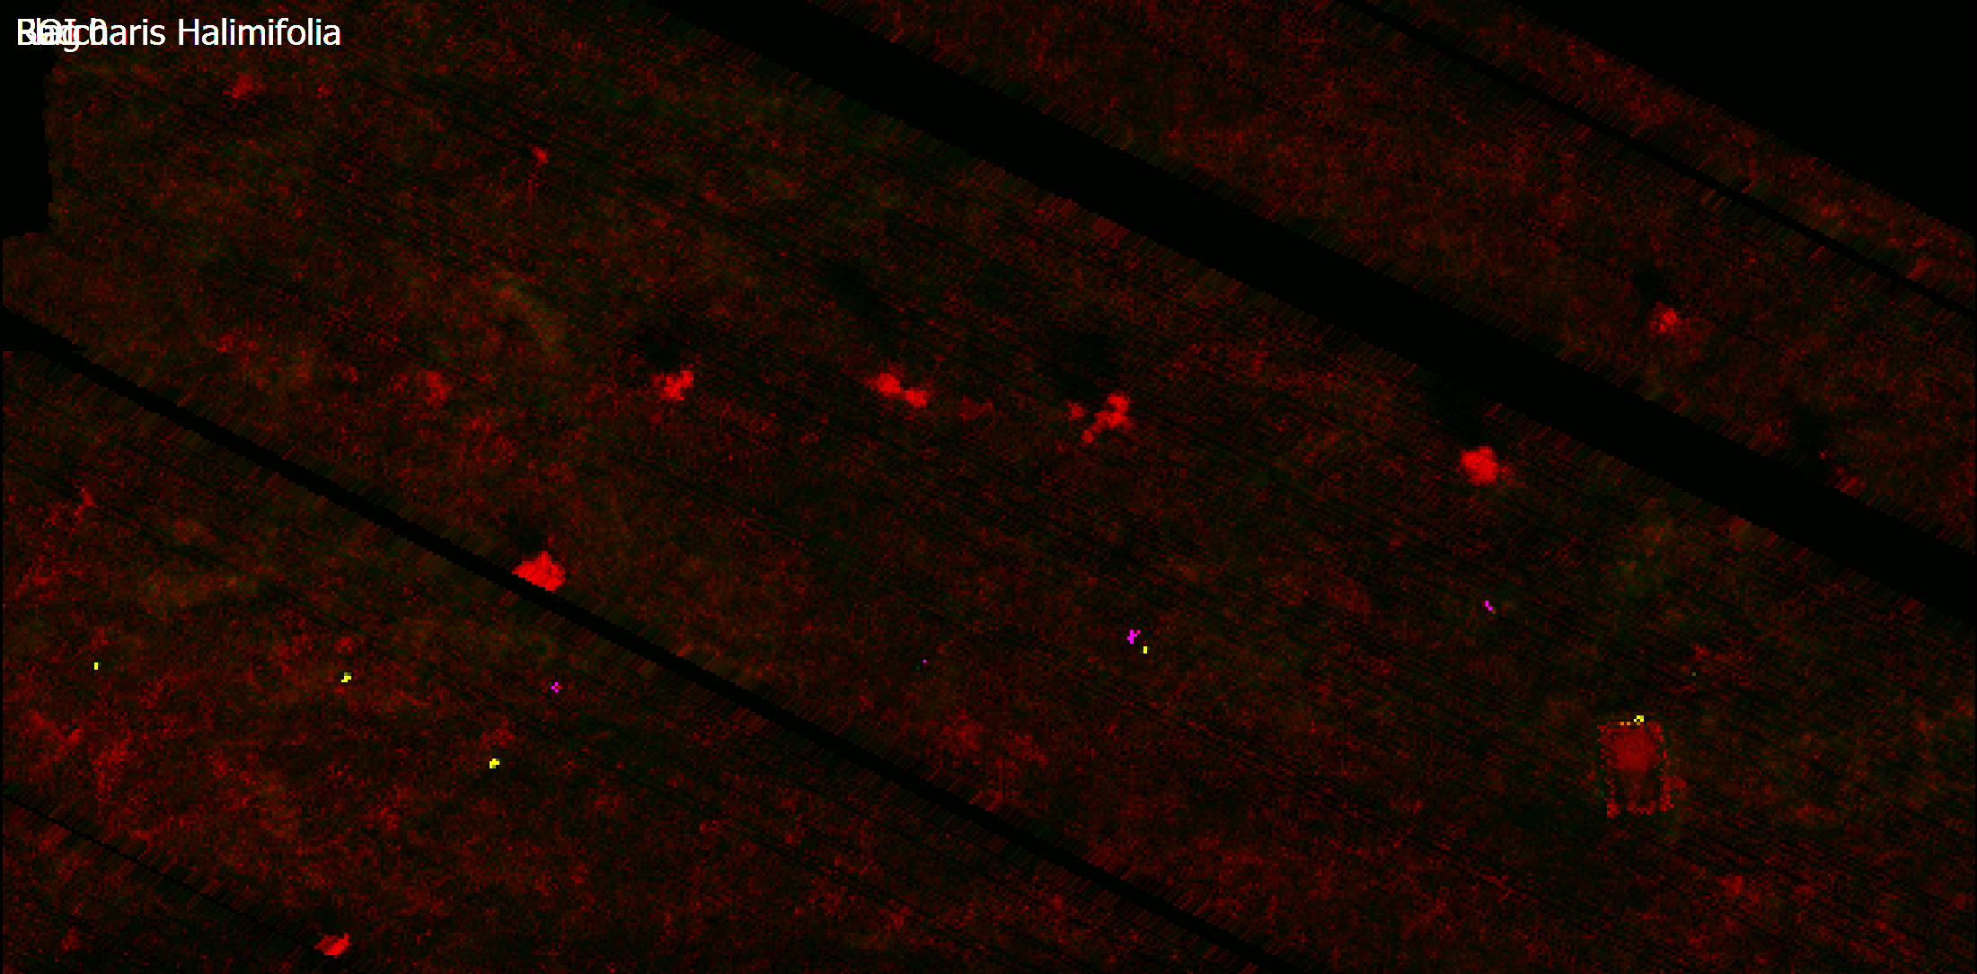
LDA Probability Image
(from in-scene pixels)
(shadow is visible,
plant is in non-data area)
((flags were moved off the plants for collection)

Slide 7
Methods

Slide 8
Results

Slide 9
Conlusions

